Slide 1
Entrepreneurship & Innovation
At the heart of École Polytechnique, a world-class institute for academics and research

Slide 2
our dna
Entrepreneurship & Innovation

Slide 3
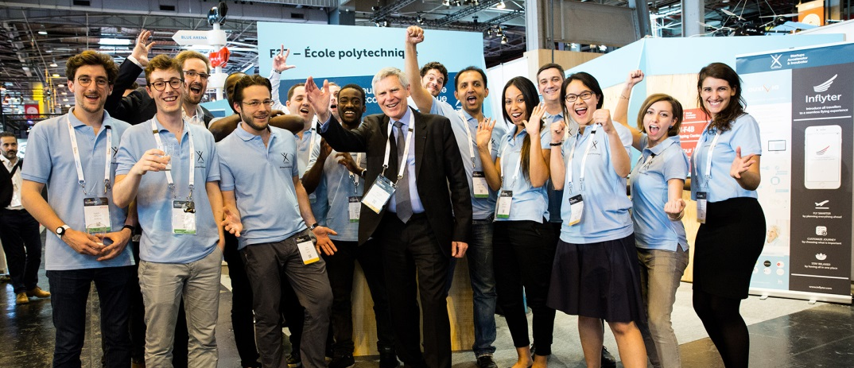
innovation, the driving force of prosperity
our dna
Since 1794, we contribute to the growth of the global economy.
The school produces socially responsible professionals who excel in leading complex and innovative projects, which address current and future challenges facing our society.
We think that growth and prosperity of all economies are strongly linked to entrepreneurial activity.
As part of our commitment to accelerating growth, the “Entrepreneurship and Innovation Program” was launched in April 2014.
Since Mid-2015, the program is located in a unique and dedicated place for entrepreneurs and innovators : “La Fibre Entrepreneur” Drahi-X Novation Center

Slide 4
Building an exceptional ecosystem
our dna
École Polytechnique does not just settle for creating knowledge. We develop an exemplary entrepreneurial ecosystem which includes the following five pillars :
Capitalize on École Polytechnique’s strengths and resources, engaged in creating disruptive innovations
Support the emergence of high-tech start-ups
Engage selected major groups and SME's in the ecosystem, encouraging interactions between business, research centers, start-ups and students
Accelerate development of a global and diversified entrepreneurial ecosystem
Stimulate the creation of jobs and sustainable value, on campus and abroad
1
2
3
4
5

Slide 5
activities
Entrepreneurship & Innovation

Slide 6
5 Activities FULLY dedicated TO ENTREPRENEURSHIP AND INNOVATION
activities
Education
Accelerator
Incubator
Prototyping
Coworking

Slide 7
Education developing entrepreneurial spirit
1
activities
A devoted entrepreneurial education…
A unique blended, multidisciplinary scientific and business education which allows students to face complex challenges, in an international environment.
Three distinct Masters programs which combine classroom lectures with hands-on experience in innovation:
IT&E (Technological Innovation: Entrepreneurship) PIC (Project, Innovation, Design)
IREN (Network Industries and the Digital Economy)
… to be completed with specific training
A set of special course modules for developing innovative entrepreneurship : MOOCs, entrepreneur guest lectures, Master Class Series, Fablab – design, etc.
Short-term programs : market exploration, lean product innovation, I.P., etc.
Student initiatives focused on science and technology

Slide 8
X-up Accelerator guiding young entrepreneurs
2
Activities
On-campus
Accelerator
for early-stage startups
6-months renewable acceleration cycle
2 batches per year, from 5 to 12 startups. Long-term goal : up to 15 startups per batch
Process essentially based around mentoring : business, technical, lean startup.
In close interaction with our international network of incubators
Involving students, laboratories, business partners and alumni
Technical and financial support
A federation of active networks of companies and entrepreneurs

Slide 9














NOs accélérés X-UP #4 : 7 projets & start-ups
TEMPO
WINDGUARD

Slide 10
Sourcing de la promo #5 en cours

Slide 11
X-tech incubator supporting startups development
3
activities
On-campus
Incubator
for innovative startups
with high growth potential
From 2 to 4 years
Strong connection with research and education departments
Near 25 years of experience
Up to 30 startups
Involving students, laboratories, business partners and alumni
Technical and financial support
A federation of active networks of companies and entrepreneurs

Slide 12











Nos incubés X-Tech, Drahi-X occupancy: 78%
AL COURAGE
SILEX
ACCENTA
CENTRE COURNOT
12

Slide 13
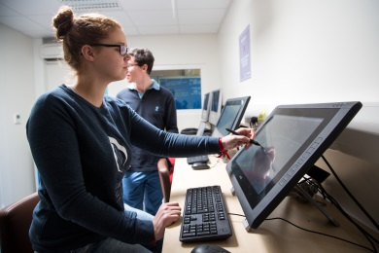
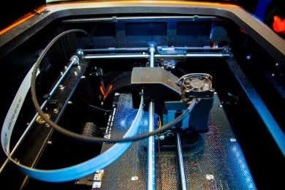
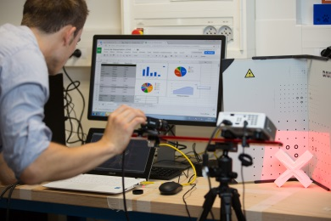
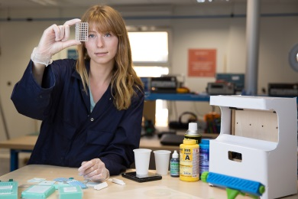
x-f4B Creating, designing, prototyping
4
activities
No innovation without prototyping, whether it’s hardware or software.
Rapid prototyping and iterating are fundamental parts of our value proposition to entrepreneurs. Our team of Fab-manager and tech development advisor support users through their prototyping projects, using 3 dedicated spaces :
FROM IDEA
TO DESIGN
FROM DESIGN
TO PROTOTYPE
FROM PROTOTYPE
TO PRE-PRODUCTION
High-quality softwares for designing, programming, 3D modeling, etc.
Numerous types of 3D printers and rapid prototyping machines (electronic and mechanical)
Advanced machines for producing first set of pieces, before launching mass production

Slide 14
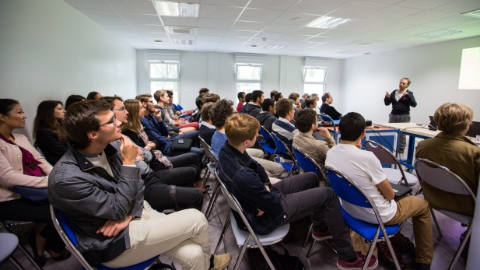
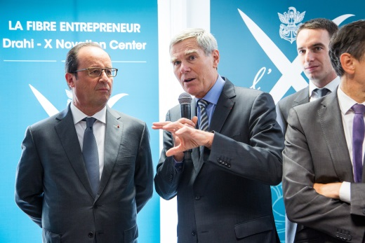
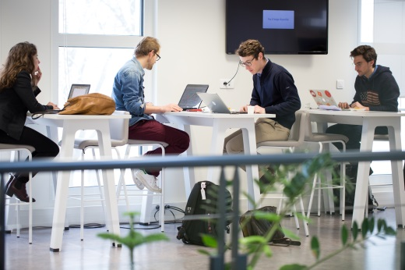
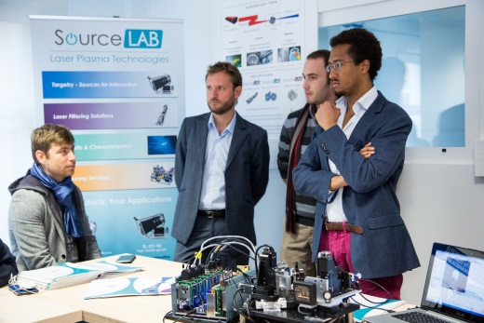
Coworking sharing more than a workspace
5
activities
Coworking space, third work place for partners’ employees
7 meeting rooms, including 1 creativity room
Events with startups, funding structures, business angels, investors and our partners
Student-organized initiatives (Start-up Week-end, Start-up Café, X-Forum, etc.)
[Soon] Tech showroom

Slide 15
Corporates
Entrepreneurship & Innovation

Slide 16
Becoming a corporate partner
corporates
#tech
#prototyping
Innovation doesn't come just from giving people incentives; it comes from creating environments where people with different backgrounds and knowledges can share and connect their ideas.
You are willing to get out of your usual R&D framework, step up your innovation cycles and share our value of excellence ?
Becoming a corporate partner means taking part in an ecosystem from which future major innovations will emerge and grow… and give your projects and people the potential to grow with them.
#delivering
#workshop
#shake
#culture
#mindset
#agility
#mutuallearning
#lean
#product
#experience
#outofthebox
#experts
#projectacceleration

Slide 17
History
Entrepreneurship & Innovation
Notes:
+ projets (Hololens, PSC Dassault,

Slide 18
2013
Conception
du programme

Slide 19
2014
Création de l’équipe
Pose des bases
du programme
Conception & lancement du bâtiment
Accord du CA
Business Plan
Notes:
Accord du CA de l’X ; Création de l’équipe ; Lancement du bâtiment ; Construction du financement

Slide 20
2015
Lancement
de
X-UP
Lancement
des grands éléments du programme
Ouverture de
X-F4B
Livraison
Drahi-X
Center
Advisory
Board
Notes:
Lancement d’X-UP ; ouverture de l’espace de prototypage ; livraison du Drahi-X Center ; création de l’Adv Board

Slide 21
X-Tech : 16 incubés
X-UP :
de 5 à 7 accélérés
Drahi-X Center : de + en + animé
2016
Initiation
de la croissance du programme
Première
accélération
corporate
Premiers
partenariats
industriels
Fréquentation
en hausse
de X-F4B
Notes:
De 5 à 7 accélérés ; 1ère accélération corporate ; fréquentation en hausse de X-F4B

Slide 22
SOME of our start-ups
Entrepreneurship & Innovation

Slide 23

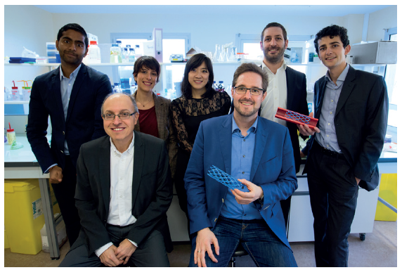
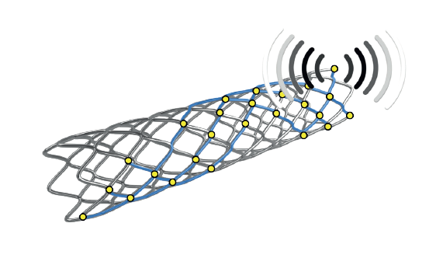
Zoom on : instent X-up batch #1
Our startups
Instent develops a novel smart stent with remote and non-invasive in situ monitoring capabilities.
Provides doctors a simple tool to anticipate stent-related complications and tailor the follow-up treatment to the needs of the individual patient.
“We can help keep patients safer, healthy, and where they belong… outside the hospital. With your support we will achieve this vision of a safer and personalized treatment for the 5 million patients every year.”
Raised 1,7 Million euros since oct 2015

Slide 24

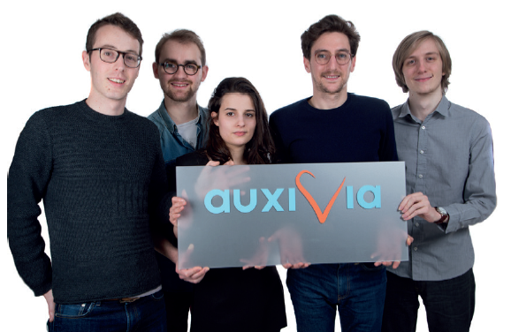

Zoom on : Auxivia X-up batch #2
Our startups
Auxivia provides smart services using connected health care objects to enhance elderly people’s quality of care in nursing homes and at home.
First AUXIVIA service is based on smart drinking glasses. It provides a reliable and scalable hydration traceability system.
The system gradually comprehends the lifestyle and habits of every user and is capable of notifying the staff on any risk detection such as a change of behavior or during hygiene risks.

Slide 25

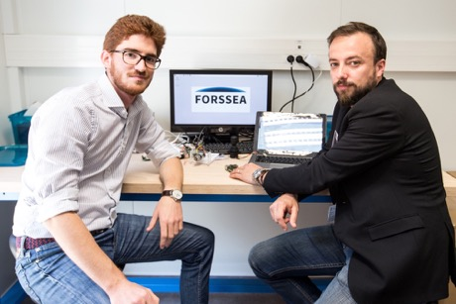
Zoom on : FORSSEA ROBOTICS X-up batch #3
Our startups
Forssea brings communication and power to deep subsea systems at a much lower cost.
ATOLL is a fully autonomous connector that leads a cable to a subsea station. The operation provides an electrical and optical physical channel between the station and a costless ship.
FORSSEA reduces the overall cost and environmental impact of the offshore operation by a factor 3 to 5

Slide 26

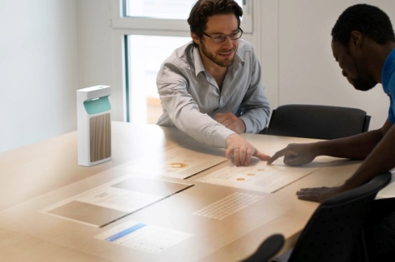
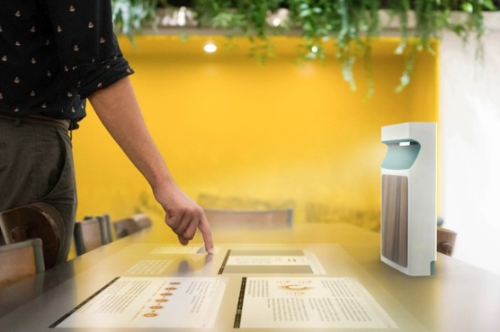
Zoom on : ADOK X-up batch #3
Our startups
ADOK makes meetings more meaningful and engaging. To do that, Adok’s first product turns any table into a giant tablet, made for multiple users.
The ADOK SC: it’s a mobile device that projects a 40 inches wide display on the table. This display is fully autonomous, touch control and powered by Android 6.
ADOK focuses on meetings from 2 to 6 people, where most of the decisions and creativity take place. We make team work easier, faster and more efficient.
20 Beta-testers, currently raising 2.5M€

Slide 27

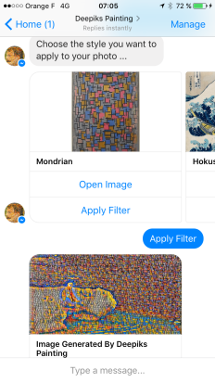
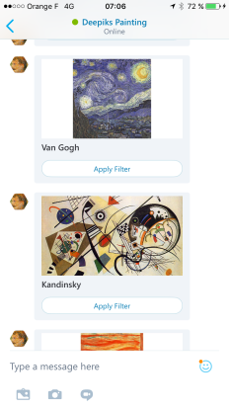
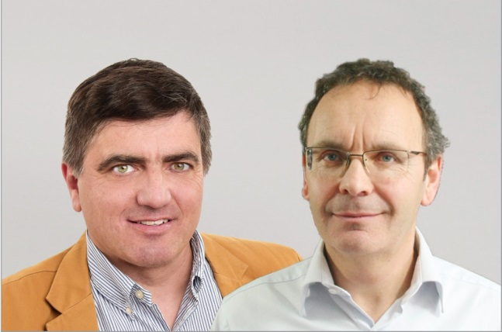
Zoom on : DEEPIKS X-up batch #3
Our startups
Deepiks provides smart chatbot platform for businesses and enterprises to create and manage their chatbots.
The platform offers various features, such as tracking, notifications, surveys, user filtering …
The company implements various AI/Deep Learning algorithms for Natural Language Understanding, content generation, and continuous chatbot improvement.

Slide 28

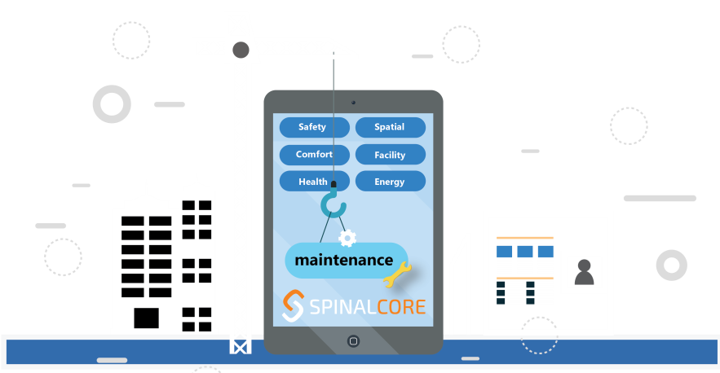




Zoom on : SPINALCOM X-TECH
Our startups
SPINALCOM has developed the Operating System of the Smart Building of the future. It enables Real-Estate, operators, integrators & services providers to make the IoT building a reality!
Provides software developers with an easy to use application enablement platform to develop smart systems combining sensors, actuators, analytics, dashboards, HMI…
Enables the owners, operators… to achieve savings on existing building services, develop new services & revenue streams and decrease building operating costs.
Real Estates
Owners
Building integrators
Operators
Tenants
Application makers Service innovators

Slide 29

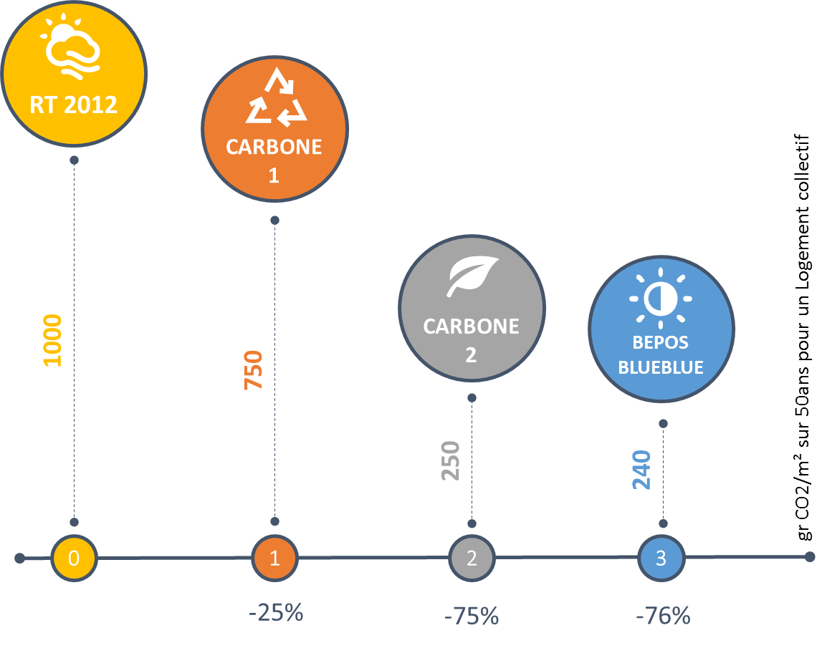
Zoom on : accenta X-TECH
Our startups
ACCENTA provides a solar energy storage solution for smart buildings, called BLUEBLUE STORAGE®.
A break-through combination of technologies for storing thermal and mechanical energy in a single « energy dwell », BLUEBLUE STORAGE® optimizes the energy autonomy of the buildings where it is installed.
Solution financially competitive with traditional fossil-fuel based energy systems
Increases dramatically the environmental performance of buildings through reducing CO2 emissions over their operating life
4 key R&D centers and 2 key commercial partners
Business Angels with outstanding recognition in the energy, engineering and technology markets

Slide 30


CONTACT
Matthieu SOMEKH
Head of Entrepreneurship & Innovation
matthieu.somekh@polytechnique.edu
+33 (0) 6 03 67 49 18
@m_somekh

